Slide 1
VMware by Broadcom Solution
Knowledge Transfer Workshop

Slide 2
Introductions and Workshop Objectives
Conceptual Design
Solution Scope
Logical Design
VCF Base Platform Design Session
Adoption for the Digital Workspace
<Process Type Name>
<Process Type Name>
<Process Type Name>
Next Steps
NOTE TO PSO Consultant/Architect:
There is no prescribed knowledge transfer deck for this microservice. Please leverage the materials available for the VMware technical marketing team.
Recommended workshop topics appear after this slide, if available. These should be adapted for the Customer as needed.

Slide 3
Introductions and Workshop Objectives
Participant introductions
What experience do you have?
Why are you attending this workshop?
What do you expect to achieve?
Expectations of the workshop
Outcomes expected of workshop
PS Consultant: Please fill out these bullet points to provide scope and expectations of this workshop.

Slide 4
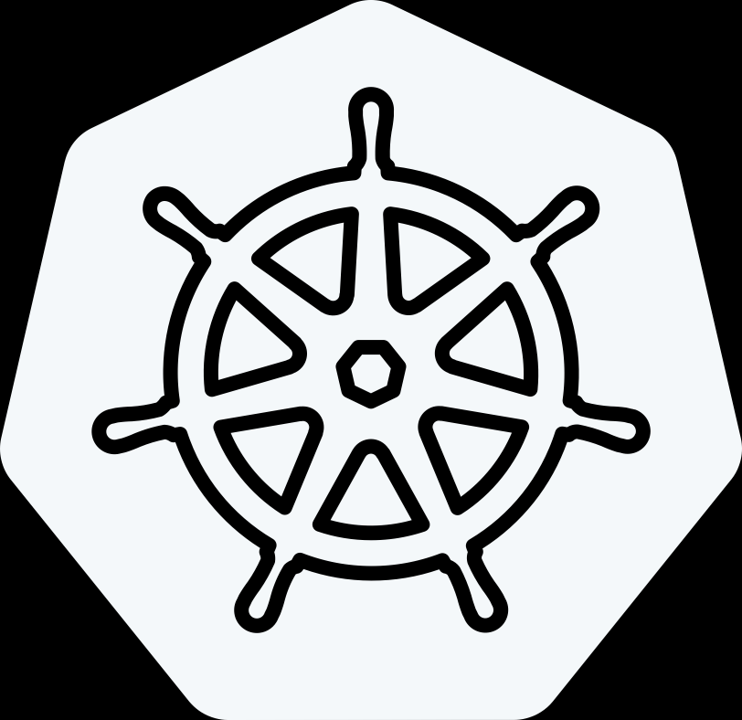
Delivering the Modern Private Cloud
VCF Advanced Services
Cyber Compliance
Advanced
Security
Load Balancing
Data Services
Application Services
Network
Observability
Business Operations
Identity Security
VMware Cloud Foundation 9
Modern Cloud Interface
Tenant Management, Content
Service Catalog, Orchestration, Applications
Private AI
Traditional VMs
K8s
Automation & Operations
Capacity, Configuration, Tenancy
SRE Ops, Fleet & Security Management,
Compute
Storage
Networking
On-Premises
Public Cloud
Sovereign Cloud
Edge
Telco
The information in this presentation is for informational purposes only and may not be incorporated
into any contract. There is no commitment or obligation to deliver any items presented herein.
Notes:
Talk Track:
Let's introduce VMware Cloud Foundation (VCF) 9 and the advanced services that are available with VCF.
VCF offers a flexible platform that can be deployed on-premises, in public clouds, within sovereign clouds, at the edge, or even in telco environments. This extensible approach allows VCF to support both traditional and modern application environments, enabling a wide range of deployment scenarios. One key feature of VCF is license portability, which we’ll explore in more detail later. This feature allows customers to take entitlements purchased on-premises and extend them across various environments, including public cloud providers, hyperscalers, sovereign clouds, edge locations, and telco environments.
When we talk about the personas that interact with VCF 9, we typically focus on two main groups: the cloud admins (formerly referred to as VI admins) and the consumers of the infrastructure. Cloud admins are responsible for deploying and managing the infrastructure from the ground up. This includes setting up the initial environment (Day 0), managing capacity, and ensuring proper configuration and tenancy for different consumers within the system.
Cloud admins are also focused on site reliability engineering, ensuring operational efficiencies are in place to scale effectively. They manage the underlying infrastructure for compute, storage, and networking, utilizing core VMware technologies like vSphere, vSAN, and NSX, as well as other networking technologies. All of this is integrated through an operational layer that provides fleet management, security, and automation, allowing the cloud admin to deliver a private cloud platform as a service. This infrastructure supports traditional VM-based applications, Kubernetes for container orchestration, and even AI and machine learning environments, including generative AI.
On the other side, consumers leverage the infrastructure-as-a-service (IaaS) components, which are abstracted for compute, storage, and networking. These services provide a framework for developers, platform teams, and DevOps teams to use IaaS and deploy multi-tenant environments. The platform manager oversees tenant management, ensuring everything is organized within a self-service catalog. This allows users to blueprint standardized models for deploying new applications, which include security, networking, storage, and compute requirements—such as GPU allocation. Once these models are configured, they can be easily deployed each time a consumer needs to build a new application cluster.
This setup also includes orchestration tools and application services necessary for a complete developer environment. Much of this is powered by the embedded Kubernetes runtime (VKE), the vSphere Kubernetes service, and associated services, which combine IaaS components with the other elements required to deliver a modern application environment. Together, cloud admins and consumers leverage VCF as a private cloud platform to deliver these services at scale.
Beyond the core VCF platform, VMware also offers a portfolio of advanced services to cover key use cases like private AI, disaster recovery, ransomware protection, advanced security (including cybersecurity measures for malware and ransomware), load balancing, application services, data services (such as database-as-a-service), network observability, business operations, and secure access. We’ll dive deeper into these advanced services in a future module.
Consumers can access these services through their preferred language, whether it's APIs, CLIs, or infrastructure-as-code, providing a flexible and scalable platform that meets a variety of needs.

Slide 5

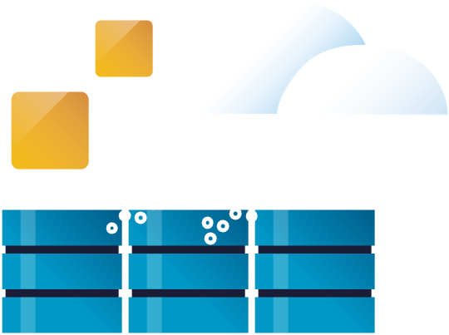








9 Common Use Cases for Private Cloud
Infrastructure Modernization
Application Modernization
Security Modernization
Build and deploy private cloud infrastructure on-premises
Enable self-service infrastructure and cloud services for app teams.
Strengthen compliance and harden infrastructure
Optimize infrastructure and operations
Build, run and manage Kubernetes and other modern workloads
Bolster lateral security and intrusions prevention/ detection
Extend data center to the Edge, public and sovereign clouds
Build, run and manage Private AI apps
Accelerate recovery from ransomware and other disasters
Notes:
Now that we’ve covered what VMware Cloud Foundation delivers, let’s look at how customers are putting it to work.
These nine use cases reflect real-world priorities we’re seeing across industries — and they map directly to the three pillars we’ve been discussing.
Under Modern Infrastructure, customers are building private cloud platforms to replace aging three-tier infrastructure — modernizing their core data centers with automated provisioning and full-stack lifecycle management.
Others are extending their private cloud out to edge locations, like retail stores and manufacturing facilities, where they need cloud services close to users and devices.
And many are delivering Infrastructure as a Service internally — providing dev teams or business units with on-demand access to compute, storage, and network resources without manual IT bottlenecks.
Under the Unified Cloud Experience pillar, organizations are accelerating application modernization by running Kubernetes clusters alongside VMs
We’re also seeing customers enabling Private AI — deploying NVIDIA GPUs on VCF to support AI model training and inferencing, all within their secure private cloud environment.
And they’re using DevOps principles like infrastructure as code to drive faster innovation across development and operations teams.
And finally, when it comes to a Secure and Resilient Platform, VCF helps organizations deliver ransomware protection by leveraging automated backup and recovery solutions integrated into the stack.
They’re deploying disaster recovery as a service between sites using VMware tools like VMware Live Recovery which is an advanced service for VCF.
And they’re ensuring continuous compliance for industries like finance and healthcare by embedding security policies at the infrastructure level.
These examples highlight how VCF helps organizations build modern infrastructure, create a seamless cloud experience across environments, and strengthen their security and resilience at every layer.

Slide 6
VMware Solution
Logical Diagram
PSO Consultant: Insert appropriate logical diagrams based on the current solution.

Slide 7
Solution Scope
The table below lists the scope of the engagement in the context of the VMware journey model. These are the IT Capabilities that have been determined as the focus for this engagement
IT Capabilities in Scope
Deliver containers and functions on demand

Slide 8
Solution Scope
The table below lists the scope of the engagement in the context of the VMware journey model. These are the IT Problems that have been determined as the focus for this engagement
IT Problems in Scope
Manual process causing developments deploys
Takes too long to deploy applications onto application infrastructure
Manual process causing development delays
Application deployments are not standardized
High cost for Test and QA
Developers using unsecured application stacks
Security management is manual and often delayed

Slide 9
VMware Solution
Logical Diagram
PSO Consultant: Insert appropriate logical diagrams based on the current solution. Review the diagram, covering each component and its function

Slide 10
Engagement Scope - Technical
This specific engagement by VMware Professional Services included the following components of the VMware Solution. This Solution Design content will only refer to these components.
Technology Components | Version
VMware Cloud Foundation | 9.0.x

Slide 11
Engagement Scope - People and Process
This specific engagement by VMware Professional Services included the following components of the VMware Solution. This Solution Design content will only refer to these components.
People and Process Components
Consultant:
Before giving this presentation to any customer use the information in Solution Builder to define the products and the process types that are included in scope of this engagement.

Slide 12
VMware Cloud Foundation 9.0.x
vSphere Kubernetes Service

Slide 13
Product Overview
VMware Cloud Foundation 9.0.x – vSphere Kubernetes Service

Slide 14


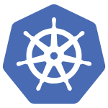
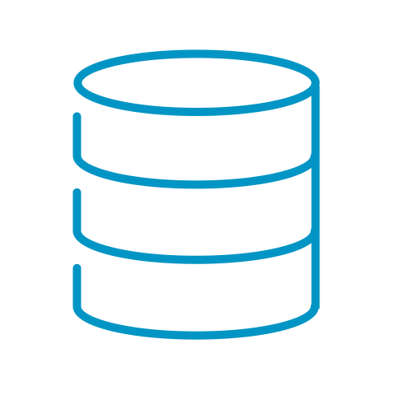

Unlock Cloud Experience with vSphere Supervisor
Deliver a consistent Service consumption experience with an embedded Declarative API
Supervisor Services
Deploy and manage Virtual Machines, Kubernetes clusters, and other resources using a single API
vSphere Supervisor provides an extensible ecosystem with Supervisor Services
Add new functionality when needed while providing a consistent consumption experience
Certificate Management
Secret Store
Operators
Operators
TKG Service
vSphere Kubernetes Service (VKS)
VM Service
Network Service
Storage and Data Services
Backup Service
Image Registry
Supervisor Control Plane
Supervisor
Notes:
Key Message:
vSphere Supervisor is an integral part of the Cloud Experience story.
Talk Track:
vSphere Supervisor is an embedded Declarative API allowing customers to deploy and manage Virtual Machines, Kubernetes clusters, and other resources, all on the same platform and using a unified set of tools.
On enablement it provides a set of Core Supervisor Services, which include:
vSphere Kubernetes Service (VKS) – allowing customers to deploy and manage fully conformant Kubernetes clusters
VM Service – allowing customers to deploy Virtual Machines using desired state
Network Service – allowing customers to deploy load balancers on-demand
Storage and Data Services – allowing customers to deploy Persistent Volumes on-demand
Customers can deploy additional Supervisor Services to provided additional functionality for their workloads, like an Image Registry (Harbor) or a Secret Store
vSphere Supervisor is a Kubernetes-based ecosystem that’s highly extensible allowing us to introduce new Services while maintaining the same consumption experience.
Notes:
Resources:

Slide 15
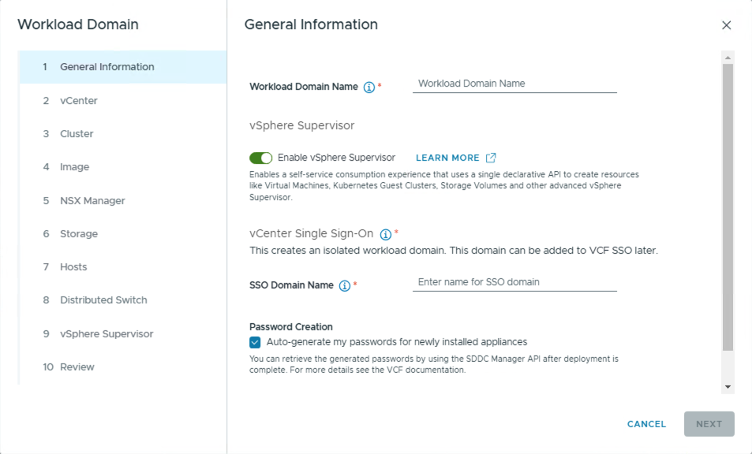

Enable vSphere Supervisor during Workload Domain creation
Providing consumption ready environments at scale
Notes:
Key Message: Cloud admins can quickly and easily enable vSphere Supervisor as part of the Workload Domain creation. Talk Track: VCF Operations contains an in-built workflows to create new Workload Domains pre-configured with the vSphere Supervisor. This option provides an opinionated way of deploying Supervisor and relies on minimal input from customers. This deployment model utilises NSX Projects and VPCs which can be selected from the drop-down menu.
Notes: Customers must complete NSX Edge deployment after the WLD creation.
Resources:

Slide 16

vSphere Supervisor
Focus on what you need, not how to get there
vSphere Supervisor is an integrated Kubernetes-based Declarative API
Define what you want, let the system figure out how to make it happen
Deploy Kubernetes Clusters with vSphere Kubernetes Service
Deploy Virtual Machines with VM Service
Add additional Supervisor Services to extend the capabilities of the platform
Kubernetes Applications
Kubernetes Applications
VM
VM
Pod
Pod
Pod
Control Plane
VM
Pod
Pod
Pod
Control Plane
Pod
Pod
Pod
Pod
Pod
Pod
Pod
Pod
Pod
Node
Node
Node
Pod
Pod
Pod
Node
Node
Node
vSphere Pods
Kubernetes Cluster
vSphere Pods
Kubernetes Cluster
vSphere Pods
vSphere Namespace
vSphere Namespace
Service vSphere Namespace
Kubernetes Service (VKS)
VM Service
Supervisor Service (i.e. Harbor)
Supervisor Control Plane
Supervisor
Notes:
Key Message:
vSphere Supervisor transforms VCF into a platform capable of running modernised workloads that can be managed using a single API.
Talk Track:
vSphere Supervisor is a Kubernetes-based Declarative API allowing customers to focus on the outcome, not the steps to get there.
On enablement it provides a set of Core Supervisor Services, which include:
vSphere Kubernetes Service (VKS) – allowing customers to deploy and manage fully conformant Kubernetes clusters
VM Service – allowing customers to deploy Virtual Machines using desired state
Customers can deploy additional Supervisor Services to provided additional functionality for their workloads, like an Image Registry (Harbor) or a Secret Store. Supervisor Services provide a consistent framework and independent lifecycle, allowing customers to add new versions and update them independently.
Virtual Machines, containers, and Kubernetes clusters, all running on one platform, managed by a unified set of tools.
Notes:
Resources:

Slide 17
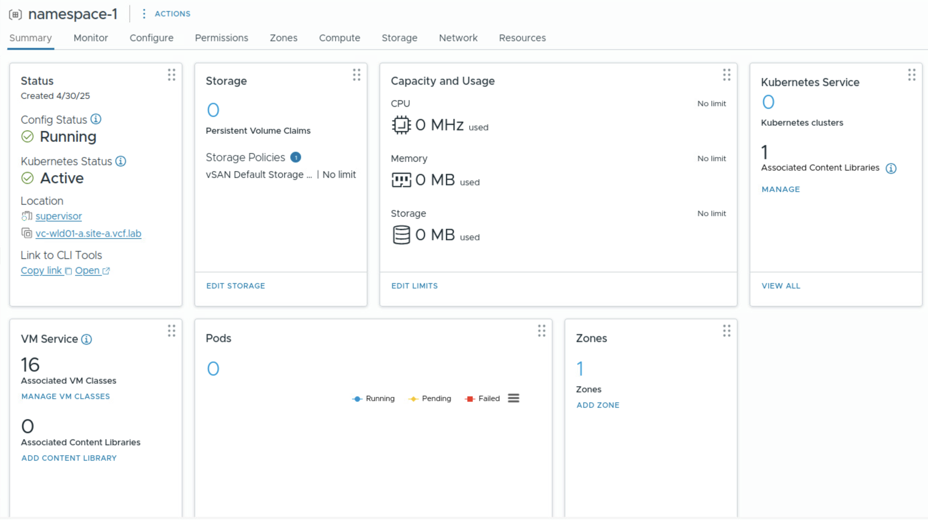
Provide workload isolation with VPC based vSphere Namespace
Creating Network Tenancy
Isolate workloads for apps, teams, or stages of development with vSphere Namespaces
Configure VM Classes and Content Libraries
VPC integration provides Network Tenancy at Namespace Level
NSX Project
namespace-1 VPC
Private Subnet
External Subnet
PrivateTGW Subnet
vSphere Namespace
Supervisor Control Plane
Supervisor
Notes:
Key Message: vSphere Namespaces are logical units providing resource and network isolation through VPC integration. Talk Track: vSphere Namespaces form a resource envelope for workloads. They are similar to resource pools, but with extended capabilities. They allow customers to set resource allocations, quotas, and limits, but also to define storage policies and zones. They also provide basic configuration options for VKS and VM Service, such as configuring Content Libraries and associating VM Classes.
<click 1>
vSphere Namespaces also provide workload isolation for organisations, whether they want to provide isolation for applications, or perhaps group them by teams. You may also want to split namespaces according to various states of development, such as test, staging, and production.
To provide greater network isolation, vSphere namespaces now integrate with VPCs. DevOps teams can configure network isolation via VPCs without needing to understand the details of the underlying network. They may create use existing VPCs, or created their own based on VPC Connectivity Profiles configured by Admins. DevOps teams can also assign their own Private IP ranges as part of VPC creation as these don’t impact other networks.
Notes: Admins will have assigned VPC Connectivity and Service Profiles to the DevOps users. Those profiles contain things like the NSX Edge, T0, External IP Blocks, Transit Gateway and Private TGW IP blocks so DevOps doesn’t need to be concerned with them.
DevOps may create their own VPC based on those profiles or use preconfigured VPCs assigned to them.
Resources:

Slide 18
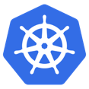
Easily deploy Kubernetes clusters with vSphere Kubernetes Service
Fully conformant Kubernetes clusters on demand in minutes
Rapid delivery of decoupled VKS releases
Support for Kubernetes 1.32
Bootstrapped with Cluster API
Photon OS, Ubuntu, and Windows support
Easy deployment and scaling
Kubernetes Applications
Kubernetes Applications
Control Plane
Control Plane
Node
Node
Node
N
N
N
Kubernetes Cluster
Kubernetes Cluster
vSphere Namespace
vSphere Kubernetes Service (VKS)
Supervisor Control Plane
Supervisor
Notes:
Key Message: VCF includes a Kubernetes runtime
Talk Track:
VKS is a Kubernetes runtime service that lets you deploy upstream aligned conformant Kubernetes clusters on demand.
New versions of the service are deliver asynchronously allowing us to ship new Kubernetes versions and functionality faster than ever before, with regular cadence. Current version, VKS 3.3 introduced support for Kubernetes 1.32, as well as other capabilities, like using cluster autoscaler to scale down to zero.
vSphere Kubernetes releases (VKrs) are distributed using a subscribed Kubernetes Service Content Library.
VKS clusters are bootstrapped with Cluster API and support Photon OS, Ubuntu, and Windows (worker nodes only).
vSphere Kubernetes Service makes Kubernetes cluster deployment very quick and easy which means that it is easily repeatable and it’s only up to you whether you decide to deploy one big cluster with lots of resources allocated to it, or you prefer to deploy smaller clusters to provide better fault isolation for your applications. Thanks to the services such as Network Service and Storage service you can seamlessly integrate with your underlying storage, and using vm class definition you can pass through additional devices such as GPU cards. You can also deploy multiple Kubernetes versions into your clusters so your teams can use them for your experimentation and testing, for example when you are trying to validate your application on a newer version of Kubernetes.
Notes:
VCF 9 will ship with VKS 3.3.1 (minor bugfixes)
Resources:

Slide 19
Modernize Virtual Machine Management with VM Service
Define Desired State for improved lifecycle
Define Desired State of a Virtual Machine and manage it with the same Declarative API
Deploy from OVF or ISO
Define resources, devices and reservations with VMclass
VM
VM
VM
vSphere Namespace
VM Service
Supervisor Control Plane
Supervisor
Notes:
Key Message:
VM Service allows users to declaratively define their Virtual machine configuration in a manifest and deploy it using the same APIs as they would deploy Kubernetes clusters. The desired state of the VM is then managed by the Supervisor. Consumers can also directly access these Virtual Machines without needing to have access to vCenter.
Talk Track:
VM Service unlocks true self-service for consumers to deploy VMs on-demand. They can declaratively define the VM specification in a YAML file and these can be stored in public repositories in a GitOps fashion. Most importantly, VM Service natively supports cloud init injections, allowing passing of configuration to the VM’s Operating system post start-up, such as setting up users, or installing and configuring an application.
VMs can be deployed using OVF templates or ISO files stored in a Content Library.
VM resources, such as Memory and CPU, reservations, or PCI devices, are defined using VM Class. There are 16 default VM classes available out of the box, coming in two flavors, guaranteed and best effort. Customers have an option to create custom VM Classes.
Notes:
Resources:

Slide 20
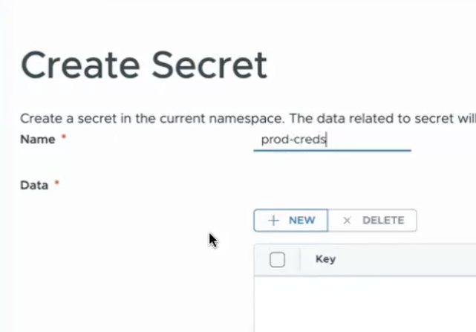
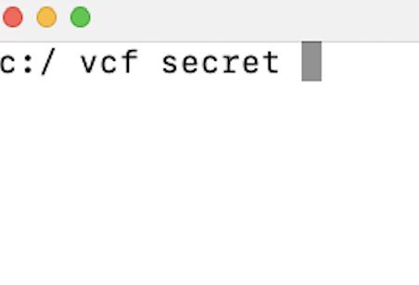
Simplify Secret Management with Secret Store
Introducing Secret Store Supervisor Service
Centralized Secret Store for Secret Management
Secret Injection into VMs, vSphere Pods and Kubernetes Pods
Encrypted Secrets by Default
vSphere namespace level isolation
Secret Injection
Kubernetes Applications
Kubernetes Applications
VM
Control Plane
VM
Control Plane
VM
P
P
P
Node
Node
Node
P
P
P
N
N
N
Kubernetes Cluster
vSphere Pods
Kubernetes Cluster
vSphere Namespace
vSphere Namespace
Service vSphere Namespace
Secret Store
Supervisor Control Plane
Supervisor
Notes:
Key Message:
A Secret Store is a centralized solution for managing, accessing, and securing secrets used by various workloads and applications.
Talk Track:
A Secret Store allows VI Admins and DevOps engineers to securely access and manage secrets with scoped permissions. Secrets can be created in the UI or using CLI, and are injected using annotations.
Notes:
Secret Store is backed by OpenBao.
Kubernetes Pods: Inject secrets via a side-car container on each Kubernetes pod with agent-inject annotations
vSphere Pods: Injects secrets via a side-car container on each pod with agent-inject annotations
VM Service VMs: Injects secrets by creating a PVC with secrets that are available at the time of creation and PVC is attached to VM. This also needs the same agent-inject annotations. Windows not supported.
Resources:

Slide 21
Creating Isolation between Control Plane and Workloads
Introducing Management and Workload Zones
Separate management Control plane VMs from workload VMs and Kubernetes clusters
Easily add capacity to vSphere Supervisor with vSphere Zones
vSphere namespaces can span one or more vSphere Zone
Add additional Zones to vSphere Namespace
Kubernetes Applications
Control Plane
VM
Node
Node
Node
Kubernetes Cluster
vSphere Namespace
Kubernetes Applications
Kubernetes Applications
Kubernetes Applications
Kubernetes Applications
VM
VM
Control Plane
Control Plane
Control Plane
Control Plane
Node
Node
Node
Node
Node
Node
Node
Node
Node
Node
Node
Node
Kubernetes Cluster
Kubernetes Cluster
Kubernetes Cluster
Kubernetes Cluster
vSphere Namespace
+ zone
Supervisor Control Plane
Supervisor
management zone
workload zone
Notes:
Key Message:
Customers can now create dedicated workload zones separated from management.
Talk Track:
Customers can now easily increase Supervisor Additional vSphere Zones can easily be added to Supervisor capacity. You do not need to deploy Supervisor control plane VMs on each cluster - although that option is still available to you. Additional vSphere clusters are added as a vSphere Zone to the Supervisor.
This also allows for the Supervisor control plane VMs to be segregated from workload VMs and vSphere Kubernetes clusters on separate vSphere clusters / vSphere Zones.
vSphere namespaces can be created to span one or more vSphere clusters / vSphere Zones.
Notes:
The first zone created during Supervisor enablement will be marked as Management.
Resources:

Slide 22

Empower Platform Operators
Introducing Supervisor Administrator Role in vCenter
Allows VI Admins to delegate Supervisor management tasks to Platform Operators
Empower Platform Operators to manage and update Supervisor and Supervisor Services
vCenter Permissions are unified to Supervisor through Kubernetes RBAC
Bridging the gap between vCenter and Supervisor permissions
vCenter
VC Role
vmware-system:Namespaces.Manage
Supervisor
Administrator
Kubernetes Role
vmware-system:Namespaces.Manage
vSphere Namespace
Supervisor
Notes:
Key Message:
VI Admins can delegate permissions to Platform Operators to allow them to perform Supervisor management tasks
Talk Track:
Because administration of a Supervisor and its services involves a combination of vCenter and Supervisor cluster privileges, it was challenging to delegate Supervisor specific responsibilities to on VI Admin users. Now the Supervisor honors VC permissions, enabling the VI Admin to assign the Supervisor Administrator Role to users. This means that corresponding Kubernetes Roles are created to map to the VC permissions. Supervisor Administrators can do things like configuring Namespaces - setting limits, adding reservations, handling access control, or managing storage policies- without full administrative access. The administrator Role extends beyond an individual Supervisor and allows configuration of the Supervisor and its supporting services.
Notes:
Resources:

Slide 23






Update vSphere Supervisor independently
Delivering Asynchronous Supervisor Releases
Update Supervisor control plane independently of vCenter
Subscribe to Broadcom depot or manage an offline Content Library to deliver updates
Faster delivery of Supervisor releases and new functionality
PLATFORM ADMIN
BROADCOM CDN
Supervisor Control Plane
Supervisor
Compute
Storage
Networking
Notes:
Key Message:
In vSphere 9, Supervisor releases are decoupled from vCenter. Supervisor clusters can be patched/updated independently of vCenter. This allows more rapid delivery of new Supervisor versions and functionality.
Talk Track:
In vSphere 8, Supervisor releases are delivered via vCenter patches and/or updates. In vSphere 9, Supervisor releases are decoupled from vCenter. Supervisor clusters can be patched/updated independently of vCenter. This allows more rapid delivery of new Supervisor releases and functionality.
Notes:
Resources:

Slide 24
Architecture
VMware Cloud Foundation 9.0.x – vSphere Kubernetes Service

Slide 25
Simplified Supervisor Model Terminology Overview
VMware Cloud Foundation with vSphere Kubernetes Service
vSphere Kubernetes Service (VKS)
Full distribution of open-source K8s, packaged, signed, and supported by VMware
vSphere Namespace:
Resource boundary where vSphere Pods and TKCs run
Manage authentication and set resource consumption policy
Supervisor Cluster:
K8s control plane running on the vSphere Cluster
Three K8s control plane VMs, Spherelet on each host
Services: Cluster API, Tanzu Kubernetes Grid
Notes:
Presenter Note – this slide includes animation
Key Message:
Introducing the key components to VMware Cloud Foundation with Tanzu.
Talk Track:
SDDC Manager contains inbuilt workflows for Virtual Infrastructure Admins to enable Kubernetes workload management on any given workload domain.
This process creates a Kubernetes control plane inside the hypervisor layer of these hosts and contains specifc objects that enable the capability to run Kubernetes workloads within ESXi.
The control plane consists of a cluster of three virtual machines which we call the Supervisor cluster. The “supervisor cluster” is a vSphere cluster where the native Kubernetes functionality provided by vSphere 7 has been enabled.
Within a VMware Cloud Foundation deployment, the Supervisor cluster runs on top of an SDDC layer and leverages ESXi for compute, NSX and vSAN or other supported shared storage options.
With Cloud Foundation, container workloads can be deployed directly on the supervisor cluster. However, it’s important to understand that the K8s version used on the Supervisor cluster is tied to the version of vSphere.
The Cluster API and Tanzu Kubernetes Grid (TKG) services are also deployed to the Supervisor Cluster when Kubernetes Workload management is enabled.
<click>
Next, the VI Admin then configures one or more vSphere Namespaces. vSphere Namespaces serve as a resource boundary for native vSphere pods to run. These native Pods would run the version of Kubernetes supported by the vSphere hypervisor. CPU, memory and storage resources within a vSphere cluster can be set and managed by the VI Admin. A Supervisor cluster can be configured to run multiple vSphere namespaces. Within the vSphere namespace, the VI Admin can manage authentication access for develop teams that wish to run Kubernetes on this infrastructure and set resource consumption policies.
<click>
Developers who wish to choose to run their own distribution of open-source Kubernetes can choose to deploy Tanzu Kubernetes Clusters (TKCs) within a vSphere Namespace rather than using native vSphere pods.
This is a more common use case and allows Developers to use the “Supervisor Cluster” as a way to bootstrap Kubernetes guest clusters using the Tanzu Kubernetes Grid (TKG) Service. The Kubernetes guest clusters created by the TKG service are commonly referred to as Tanzu Kubernetes Grid Clusters, or simply TKCs. With TKCs, Developers can deploy upstream conformant K8s using different K8s versions to a vSphere Namespace.
As such, we will focus on the TKC use case and are not calling out the native K8s capabilities.
Notes:
Native vSphere Kubernetes Pods are covered separately in a later section: Deploying Kubernetes Workloads – vSphere Pods.
Each TKC comprises of control plane node VMs (odd number) and one of more worker node VMs for the container workloads to run on.
A vSphere Namespace is created, configured and managed by the VI Admin.
A Kubernetes Namespace is different to a vSphere Namespace and is configured and managed by the developer within a TKC.
Resources:
For further detail on vSphere with Tanzu Architecture please refer to the VMware documentation:
https://docs.vmware.com/en/VMware-vSphere/7.0/vmware-vsphere-with-tanzu/GUID-3E4E6039-BD24-4C40-8575-5AA0EECBBBEC.html

Slide 26
Simplified Supervisor Model Architecture Overview
Simplified Supervisor Model
Notes:
Presenter Note – this slide includes animation
Key Message:
Introducing the key components to VMware Cloud Foundation with Tanzu.
Talk Track:
SDDC Manager contains inbuilt workflows for Virtual Infrastructure Admins to enable Kubernetes workload management on any given workload domain.
This process creates a Kubernetes control plane inside the hypervisor layer of these hosts and contains specifc objects that enable the capability to run Kubernetes workloads within ESXi.
The control plane consists of a cluster of three virtual machines which we call the Supervisor cluster. The “supervisor cluster” is a vSphere cluster where the native Kubernetes functionality provided by vSphere 7 has been enabled.
Within a VMware Cloud Foundation deployment, the Supervisor cluster runs on top of an SDDC layer and leverages ESXi for compute, NSX and vSAN or other supported shared storage options.
With Cloud Foundation, container workloads can be deployed directly on the supervisor cluster. However, it’s important to understand that the K8s version used on the Supervisor cluster is tied to the version of vSphere.
The Cluster API and Tanzu Kubernetes Grid (TKG) services are also deployed to the Supervisor Cluster when Kubernetes Workload management is enabled.
<click>
Next, the VI Admin then configures one or more vSphere Namespaces. vSphere Namespaces serve as a resource boundary for native vSphere pods to run. These native Pods would run the version of Kubernetes supported by the vSphere hypervisor. CPU, memory and storage resources within a vSphere cluster can be set and managed by the VI Admin. A Supervisor cluster can be configured to run multiple vSphere namespaces. Within the vSphere namespace, the VI Admin can manage authentication access for develop teams that wish to run Kubernetes on this infrastructure and set resource consumption policies.
<click>
Developers who wish to choose to run their own distribution of open-source Kubernetes can choose to deploy Tanzu Kubernetes Clusters (TKCs) within a vSphere Namespace rather than using native vSphere pods.
This is a more common use case and allows Developers to use the “Supervisor Cluster” as a way to bootstrap Kubernetes guest clusters using the Tanzu Kubernetes Grid (TKG) Service. The Kubernetes guest clusters created by the TKG service are commonly referred to as Tanzu Kubernetes Grid Clusters, or simply TKCs. With TKCs, Developers can deploy upstream conformant K8s using different K8s versions to a vSphere Namespace.
As such, we will focus on the TKC use case and are not calling out the native K8s capabilities.
Notes:
Native vSphere Kubernetes Pods are covered separately in a later section: Deploying Kubernetes Workloads – vSphere Pods.
Each TKC comprises of control plane node VMs (odd number) and one of more worker node VMs for the container workloads to run on.
A vSphere Namespace is created, configured and managed by the VI Admin.
A Kubernetes Namespace is different to a vSphere Namespace and is configured and managed by the developer within a TKC.
Resources:
For further detail on vSphere with Tanzu Architecture please refer to the VMware documentation:
https://docs.vmware.com/en/VMware-vSphere/7.0/vmware-vsphere-with-tanzu/GUID-3E4E6039-BD24-4C40-8575-5AA0EECBBBEC.html

Slide 27
Zone Models Architecture Overview
Single Management Zone with Combined Workload Zones Model
Notes:
Presenter Note – this slide includes animation
Key Message:
Introducing the key components to VMware Cloud Foundation with Tanzu.
Talk Track:
SDDC Manager contains inbuilt workflows for Virtual Infrastructure Admins to enable Kubernetes workload management on any given workload domain.
This process creates a Kubernetes control plane inside the hypervisor layer of these hosts and contains specifc objects that enable the capability to run Kubernetes workloads within ESXi.
The control plane consists of a cluster of three virtual machines which we call the Supervisor cluster. The “supervisor cluster” is a vSphere cluster where the native Kubernetes functionality provided by vSphere 7 has been enabled.
Within a VMware Cloud Foundation deployment, the Supervisor cluster runs on top of an SDDC layer and leverages ESXi for compute, NSX and vSAN or other supported shared storage options.
With Cloud Foundation, container workloads can be deployed directly on the supervisor cluster. However, it’s important to understand that the K8s version used on the Supervisor cluster is tied to the version of vSphere.
The Cluster API and Tanzu Kubernetes Grid (TKG) services are also deployed to the Supervisor Cluster when Kubernetes Workload management is enabled.
<click>
Next, the VI Admin then configures one or more vSphere Namespaces. vSphere Namespaces serve as a resource boundary for native vSphere pods to run. These native Pods would run the version of Kubernetes supported by the vSphere hypervisor. CPU, memory and storage resources within a vSphere cluster can be set and managed by the VI Admin. A Supervisor cluster can be configured to run multiple vSphere namespaces. Within the vSphere namespace, the VI Admin can manage authentication access for develop teams that wish to run Kubernetes on this infrastructure and set resource consumption policies.
<click>
Developers who wish to choose to run their own distribution of open-source Kubernetes can choose to deploy Tanzu Kubernetes Clusters (TKCs) within a vSphere Namespace rather than using native vSphere pods.
This is a more common use case and allows Developers to use the “Supervisor Cluster” as a way to bootstrap Kubernetes guest clusters using the Tanzu Kubernetes Grid (TKG) Service. The Kubernetes guest clusters created by the TKG service are commonly referred to as Tanzu Kubernetes Grid Clusters, or simply TKCs. With TKCs, Developers can deploy upstream conformant K8s using different K8s versions to a vSphere Namespace.
As such, we will focus on the TKC use case and are not calling out the native K8s capabilities.
Notes:
Native vSphere Kubernetes Pods are covered separately in a later section: Deploying Kubernetes Workloads – vSphere Pods.
Each TKC comprises of control plane node VMs (odd number) and one of more worker node VMs for the container workloads to run on.
A vSphere Namespace is created, configured and managed by the VI Admin.
A Kubernetes Namespace is different to a vSphere Namespace and is configured and managed by the developer within a TKC.
Resources:
For further detail on vSphere with Tanzu Architecture please refer to the VMware documentation:
https://docs.vmware.com/en/VMware-vSphere/7.0/vmware-vsphere-with-tanzu/GUID-3E4E6039-BD24-4C40-8575-5AA0EECBBBEC.html

Slide 28
Zone Models Architecture Overview
Single Management Zone with Isolated Workload Zones Model
Notes:
Presenter Note – this slide includes animation
Key Message:
Introducing the key components to VMware Cloud Foundation with Tanzu.
Talk Track:
SDDC Manager contains inbuilt workflows for Virtual Infrastructure Admins to enable Kubernetes workload management on any given workload domain.
This process creates a Kubernetes control plane inside the hypervisor layer of these hosts and contains specifc objects that enable the capability to run Kubernetes workloads within ESXi.
The control plane consists of a cluster of three virtual machines which we call the Supervisor cluster. The “supervisor cluster” is a vSphere cluster where the native Kubernetes functionality provided by vSphere 7 has been enabled.
Within a VMware Cloud Foundation deployment, the Supervisor cluster runs on top of an SDDC layer and leverages ESXi for compute, NSX and vSAN or other supported shared storage options.
With Cloud Foundation, container workloads can be deployed directly on the supervisor cluster. However, it’s important to understand that the K8s version used on the Supervisor cluster is tied to the version of vSphere.
The Cluster API and Tanzu Kubernetes Grid (TKG) services are also deployed to the Supervisor Cluster when Kubernetes Workload management is enabled.
<click>
Next, the VI Admin then configures one or more vSphere Namespaces. vSphere Namespaces serve as a resource boundary for native vSphere pods to run. These native Pods would run the version of Kubernetes supported by the vSphere hypervisor. CPU, memory and storage resources within a vSphere cluster can be set and managed by the VI Admin. A Supervisor cluster can be configured to run multiple vSphere namespaces. Within the vSphere namespace, the VI Admin can manage authentication access for develop teams that wish to run Kubernetes on this infrastructure and set resource consumption policies.
<click>
Developers who wish to choose to run their own distribution of open-source Kubernetes can choose to deploy Tanzu Kubernetes Clusters (TKCs) within a vSphere Namespace rather than using native vSphere pods.
This is a more common use case and allows Developers to use the “Supervisor Cluster” as a way to bootstrap Kubernetes guest clusters using the Tanzu Kubernetes Grid (TKG) Service. The Kubernetes guest clusters created by the TKG service are commonly referred to as Tanzu Kubernetes Grid Clusters, or simply TKCs. With TKCs, Developers can deploy upstream conformant K8s using different K8s versions to a vSphere Namespace.
As such, we will focus on the TKC use case and are not calling out the native K8s capabilities.
Notes:
Native vSphere Kubernetes Pods are covered separately in a later section: Deploying Kubernetes Workloads – vSphere Pods.
Each TKC comprises of control plane node VMs (odd number) and one of more worker node VMs for the container workloads to run on.
A vSphere Namespace is created, configured and managed by the VI Admin.
A Kubernetes Namespace is different to a vSphere Namespace and is configured and managed by the developer within a TKC.
Resources:
For further detail on vSphere with Tanzu Architecture please refer to the VMware documentation:
https://docs.vmware.com/en/VMware-vSphere/7.0/vmware-vsphere-with-tanzu/GUID-3E4E6039-BD24-4C40-8575-5AA0EECBBBEC.html

Slide 29
Zone Models Architecture Overview
Three Management Zones with Combined Workload Zones Model
Notes:
Presenter Note – this slide includes animation
Key Message:
Introducing the key components to VMware Cloud Foundation with Tanzu.
Talk Track:
SDDC Manager contains inbuilt workflows for Virtual Infrastructure Admins to enable Kubernetes workload management on any given workload domain.
This process creates a Kubernetes control plane inside the hypervisor layer of these hosts and contains specific objects that enable the capability to run Kubernetes workloads within ESXi.
The control plane consists of a cluster of three virtual machines which we call the Supervisor cluster. The “supervisor cluster” is a vSphere cluster where the native Kubernetes functionality provided by vSphere 7 has been enabled.
Within a VMware Cloud Foundation deployment, the Supervisor cluster runs on top of an SDDC layer and leverages ESXi for compute, NSX and vSAN or other supported shared storage options.
With Cloud Foundation, container workloads can be deployed directly on the supervisor cluster. However, it’s important to understand that the K8s version used on the Supervisor cluster is tied to the version of vSphere.
The Cluster API and Tanzu Kubernetes Grid (TKG) services are also deployed to the Supervisor Cluster when Kubernetes Workload management is enabled.
<click>
Next, the VI Admin then configures one or more vSphere Namespaces. vSphere Namespaces serve as a resource boundary for native vSphere pods to run. These native Pods would run the version of Kubernetes supported by the vSphere hypervisor. CPU, memory and storage resources within a vSphere cluster can be set and managed by the VI Admin. A Supervisor cluster can be configured to run multiple vSphere namespaces. Within the vSphere namespace, the VI Admin can manage authentication access for develop teams that wish to run Kubernetes on this infrastructure and set resource consumption policies.
<click>
Developers who wish to choose to run their own distribution of open-source Kubernetes can choose to deploy Tanzu Kubernetes Clusters (TKCs) within a vSphere Namespace rather than using native vSphere pods.
This is a more common use case and allows Developers to use the “Supervisor Cluster” as a way to bootstrap Kubernetes guest clusters using the Tanzu Kubernetes Grid (TKG) Service. The Kubernetes guest clusters created by the TKG service are commonly referred to as Tanzu Kubernetes Grid Clusters, or simply TKCs. With TKCs, Developers can deploy upstream conformant K8s using different K8s versions to a vSphere Namespace.
As such, we will focus on the TKC use case and are not calling out the native K8s capabilities.
Notes:
Native vSphere Kubernetes Pods are covered separately in a later section: Deploying Kubernetes Workloads – vSphere Pods.
Each TKC comprises of control plane node VMs (odd number) and one of more worker node VMs for the container workloads to run on.
A vSphere Namespace is created, configured and managed by the VI Admin.
A Kubernetes Namespace is different to a vSphere Namespace and is configured and managed by the developer within a TKC.
Resources:
For further detail on vSphere with Tanzu Architecture please refer to the VMware documentation:
https://docs.vmware.com/en/VMware-vSphere/7.0/vmware-vsphere-with-tanzu/GUID-3E4E6039-BD24-4C40-8575-5AA0EECBBBEC.html

Slide 30
Zone Models Architecture Overview
Three Management Zones with Isolated Workload Zones Model
Notes:
Presenter Note – this slide includes animation
Key Message:
Introducing the key components to VMware Cloud Foundation with Tanzu.
Talk Track:
SDDC Manager contains inbuilt workflows for Virtual Infrastructure Admins to enable Kubernetes workload management on any given workload domain.
This process creates a Kubernetes control plane inside the hypervisor layer of these hosts and contains specific objects that enable the capability to run Kubernetes workloads within ESXi.
The control plane consists of a cluster of three virtual machines which we call the Supervisor cluster. The “supervisor cluster” is a vSphere cluster where the native Kubernetes functionality provided by vSphere 7 has been enabled.
Within a VMware Cloud Foundation deployment, the Supervisor cluster runs on top of an SDDC layer and leverages ESXi for compute, NSX and vSAN or other supported shared storage options.
With Cloud Foundation, container workloads can be deployed directly on the supervisor cluster. However, it’s important to understand that the K8s version used on the Supervisor cluster is tied to the version of vSphere.
The Cluster API and Tanzu Kubernetes Grid (TKG) services are also deployed to the Supervisor Cluster when Kubernetes Workload management is enabled.
<click>
Next, the VI Admin then configures one or more vSphere Namespaces. vSphere Namespaces serve as a resource boundary for native vSphere pods to run. These native Pods would run the version of Kubernetes supported by the vSphere hypervisor. CPU, memory and storage resources within a vSphere cluster can be set and managed by the VI Admin. A Supervisor cluster can be configured to run multiple vSphere namespaces. Within the vSphere namespace, the VI Admin can manage authentication access for develop teams that wish to run Kubernetes on this infrastructure and set resource consumption policies.
<click>
Developers who wish to choose to run their own distribution of open-source Kubernetes can choose to deploy Tanzu Kubernetes Clusters (TKCs) within a vSphere Namespace rather than using native vSphere pods.
This is a more common use case and allows Developers to use the “Supervisor Cluster” as a way to bootstrap Kubernetes guest clusters using the Tanzu Kubernetes Grid (TKG) Service. The Kubernetes guest clusters created by the TKG service are commonly referred to as Tanzu Kubernetes Grid Clusters, or simply TKCs. With TKCs, Developers can deploy upstream conformant K8s using different K8s versions to a vSphere Namespace.
As such, we will focus on the TKC use case and are not calling out the native K8s capabilities.
Notes:
Native vSphere Kubernetes Pods are covered separately in a later section: Deploying Kubernetes Workloads – vSphere Pods.
Each TKC comprises of control plane node VMs (odd number) and one of more worker node VMs for the container workloads to run on.
A vSphere Namespace is created, configured and managed by the VI Admin.
A Kubernetes Namespace is different to a vSphere Namespace and is configured and managed by the developer within a TKC.
Resources:
For further detail on vSphere with Tanzu Architecture please refer to the VMware documentation:
https://docs.vmware.com/en/VMware-vSphere/7.0/vmware-vsphere-with-tanzu/GUID-3E4E6039-BD24-4C40-8575-5AA0EECBBBEC.html

Slide 31
Control Plane Availability Model Architecture Overview
Simple Control Plane Model
Notes:
Presenter Note – this slide includes animation
Key Message:
Introducing the key components to VMware Cloud Foundation with Tanzu.
Talk Track:
SDDC Manager contains inbuilt workflows for Virtual Infrastructure Admins to enable Kubernetes workload management on any given workload domain.
This process creates a Kubernetes control plane inside the hypervisor layer of these hosts and contains specific objects that enable the capability to run Kubernetes workloads within ESXi.
The control plane consists of a cluster of three virtual machines which we call the Supervisor cluster. The “supervisor cluster” is a vSphere cluster where the native Kubernetes functionality provided by vSphere 7 has been enabled.
Within a VMware Cloud Foundation deployment, the Supervisor cluster runs on top of an SDDC layer and leverages ESXi for compute, NSX and vSAN or other supported shared storage options.
With Cloud Foundation, container workloads can be deployed directly on the supervisor cluster. However, it’s important to understand that the K8s version used on the Supervisor cluster is tied to the version of vSphere.
The Cluster API and Tanzu Kubernetes Grid (TKG) services are also deployed to the Supervisor Cluster when Kubernetes Workload management is enabled.
<click>
Next, the VI Admin then configures one or more vSphere Namespaces. vSphere Namespaces serve as a resource boundary for native vSphere pods to run. These native Pods would run the version of Kubernetes supported by the vSphere hypervisor. CPU, memory and storage resources within a vSphere cluster can be set and managed by the VI Admin. A Supervisor cluster can be configured to run multiple vSphere namespaces. Within the vSphere namespace, the VI Admin can manage authentication access for develop teams that wish to run Kubernetes on this infrastructure and set resource consumption policies.
<click>
Developers who wish to choose to run their own distribution of open-source Kubernetes can choose to deploy Tanzu Kubernetes Clusters (TKCs) within a vSphere Namespace rather than using native vSphere pods.
This is a more common use case and allows Developers to use the “Supervisor Cluster” as a way to bootstrap Kubernetes guest clusters using the Tanzu Kubernetes Grid (TKG) Service. The Kubernetes guest clusters created by the TKG service are commonly referred to as Tanzu Kubernetes Grid Clusters, or simply TKCs. With TKCs, Developers can deploy upstream conformant K8s using different K8s versions to a vSphere Namespace.
As such, we will focus on the TKC use case and are not calling out the native K8s capabilities.
Notes:
Native vSphere Kubernetes Pods are covered separately in a later section: Deploying Kubernetes Workloads – vSphere Pods.
Each TKC comprises of control plane node VMs (odd number) and one of more worker node VMs for the container workloads to run on.
A vSphere Namespace is created, configured and managed by the VI Admin.
A Kubernetes Namespace is different to a vSphere Namespace and is configured and managed by the developer within a TKC.
Resources:
For further detail on vSphere with Tanzu Architecture please refer to the VMware documentation:
https://docs.vmware.com/en/VMware-vSphere/7.0/vmware-vsphere-with-tanzu/GUID-3E4E6039-BD24-4C40-8575-5AA0EECBBBEC.html

Slide 32
Control Plane Availability Model Architecture Overview
High Availability Control Plane Model – Single Management Zone
Notes:
Presenter Note – this slide includes animation
Key Message:
Introducing the key components to VMware Cloud Foundation with Tanzu.
Talk Track:
SDDC Manager contains inbuilt workflows for Virtual Infrastructure Admins to enable Kubernetes workload management on any given workload domain.
This process creates a Kubernetes control plane inside the hypervisor layer of these hosts and contains specifc objects that enable the capability to run Kubernetes workloads within ESXi.
The control plane consists of a cluster of three virtual machines which we call the Supervisor cluster. The “supervisor cluster” is a vSphere cluster where the native Kubernetes functionality provided by vSphere 7 has been enabled.
Within a VMware Cloud Foundation deployment, the Supervisor cluster runs on top of an SDDC layer and leverages ESXi for compute, NSX and vSAN or other supported shared storage options.
With Cloud Foundation, container workloads can be deployed directly on the supervisor cluster. However, it’s important to understand that the K8s version used on the Supervisor cluster is tied to the version of vSphere.
The Cluster API and Tanzu Kubernetes Grid (TKG) services are also deployed to the Supervisor Cluster when Kubernetes Workload management is enabled.
<click>
Next, the VI Admin then configures one or more vSphere Namespaces. vSphere Namespaces serve as a resource boundary for native vSphere pods to run. These native Pods would run the version of Kubernetes supported by the vSphere hypervisor. CPU, memory and storage resources within a vSphere cluster can be set and managed by the VI Admin. A Supervisor cluster can be configured to run multiple vSphere namespaces. Within the vSphere namespace, the VI Admin can manage authentication access for develop teams that wish to run Kubernetes on this infrastructure and set resource consumption policies.
<click>
Developers who wish to choose to run their own distribution of open-source Kubernetes can choose to deploy Tanzu Kubernetes Clusters (TKCs) within a vSphere Namespace rather than using native vSphere pods.
This is a more common use case and allows Developers to use the “Supervisor Cluster” as a way to bootstrap Kubernetes guest clusters using the Tanzu Kubernetes Grid (TKG) Service. The Kubernetes guest clusters created by the TKG service are commonly referred to as Tanzu Kubernetes Grid Clusters, or simply TKCs. With TKCs, Developers can deploy upstream conformant K8s using different K8s versions to a vSphere Namespace.
As such, we will focus on the TKC use case and are not calling out the native K8s capabilities.
Notes:
Native vSphere Kubernetes Pods are covered separately in a later section: Deploying Kubernetes Workloads – vSphere Pods.
Each TKC comprises of control plane node VMs (odd number) and one of more worker node VMs for the container workloads to run on.
A vSphere Namespace is created, configured and managed by the VI Admin.
A Kubernetes Namespace is different to a vSphere Namespace and is configured and managed by the developer within a TKC.
Resources:
For further detail on vSphere with Tanzu Architecture please refer to the VMware documentation:
https://docs.vmware.com/en/VMware-vSphere/7.0/vmware-vsphere-with-tanzu/GUID-3E4E6039-BD24-4C40-8575-5AA0EECBBBEC.html

Slide 33
Control Plane Availability Model Architecture Overview
High Availability Control Plane Model – Three Management Zone
Notes:
Presenter Note – this slide includes animation
Key Message:
Introducing the key components to VMware Cloud Foundation with Tanzu.
Talk Track:
SDDC Manager contains inbuilt workflows for Virtual Infrastructure Admins to enable Kubernetes workload management on any given workload domain.
This process creates a Kubernetes control plane inside the hypervisor layer of these hosts and contains specifc objects that enable the capability to run Kubernetes workloads within ESXi.
The control plane consists of a cluster of three virtual machines which we call the Supervisor cluster. The “supervisor cluster” is a vSphere cluster where the native Kubernetes functionality provided by vSphere 7 has been enabled.
Within a VMware Cloud Foundation deployment, the Supervisor cluster runs on top of an SDDC layer and leverages ESXi for compute, NSX and vSAN or other supported shared storage options.
With Cloud Foundation, container workloads can be deployed directly on the supervisor cluster. However, it’s important to understand that the K8s version used on the Supervisor cluster is tied to the version of vSphere.
The Cluster API and Tanzu Kubernetes Grid (TKG) services are also deployed to the Supervisor Cluster when Kubernetes Workload management is enabled.
<click>
Next, the VI Admin then configures one or more vSphere Namespaces. vSphere Namespaces serve as a resource boundary for native vSphere pods to run. These native Pods would run the version of Kubernetes supported by the vSphere hypervisor. CPU, memory and storage resources within a vSphere cluster can be set and managed by the VI Admin. A Supervisor cluster can be configured to run multiple vSphere namespaces. Within the vSphere namespace, the VI Admin can manage authentication access for develop teams that wish to run Kubernetes on this infrastructure and set resource consumption policies.
<click>
Developers who wish to choose to run their own distribution of open-source Kubernetes can choose to deploy Tanzu Kubernetes Clusters (TKCs) within a vSphere Namespace rather than using native vSphere pods.
This is a more common use case and allows Developers to use the “Supervisor Cluster” as a way to bootstrap Kubernetes guest clusters using the Tanzu Kubernetes Grid (TKG) Service. The Kubernetes guest clusters created by the TKG service are commonly referred to as Tanzu Kubernetes Grid Clusters, or simply TKCs. With TKCs, Developers can deploy upstream conformant K8s using different K8s versions to a vSphere Namespace.
As such, we will focus on the TKC use case and are not calling out the native K8s capabilities.
Notes:
Native vSphere Kubernetes Pods are covered separately in a later section: Deploying Kubernetes Workloads – vSphere Pods.
Each TKC comprises of control plane node VMs (odd number) and one of more worker node VMs for the container workloads to run on.
A vSphere Namespace is created, configured and managed by the VI Admin.
A Kubernetes Namespace is different to a vSphere Namespace and is configured and managed by the developer within a TKC.
Resources:
For further detail on vSphere with Tanzu Architecture please refer to the VMware documentation:
https://docs.vmware.com/en/VMware-vSphere/7.0/vmware-vsphere-with-tanzu/GUID-3E4E6039-BD24-4C40-8575-5AA0EECBBBEC.html

